Slide 1
Sporty Shoes Website Prototype
Screenshots

Slide 2
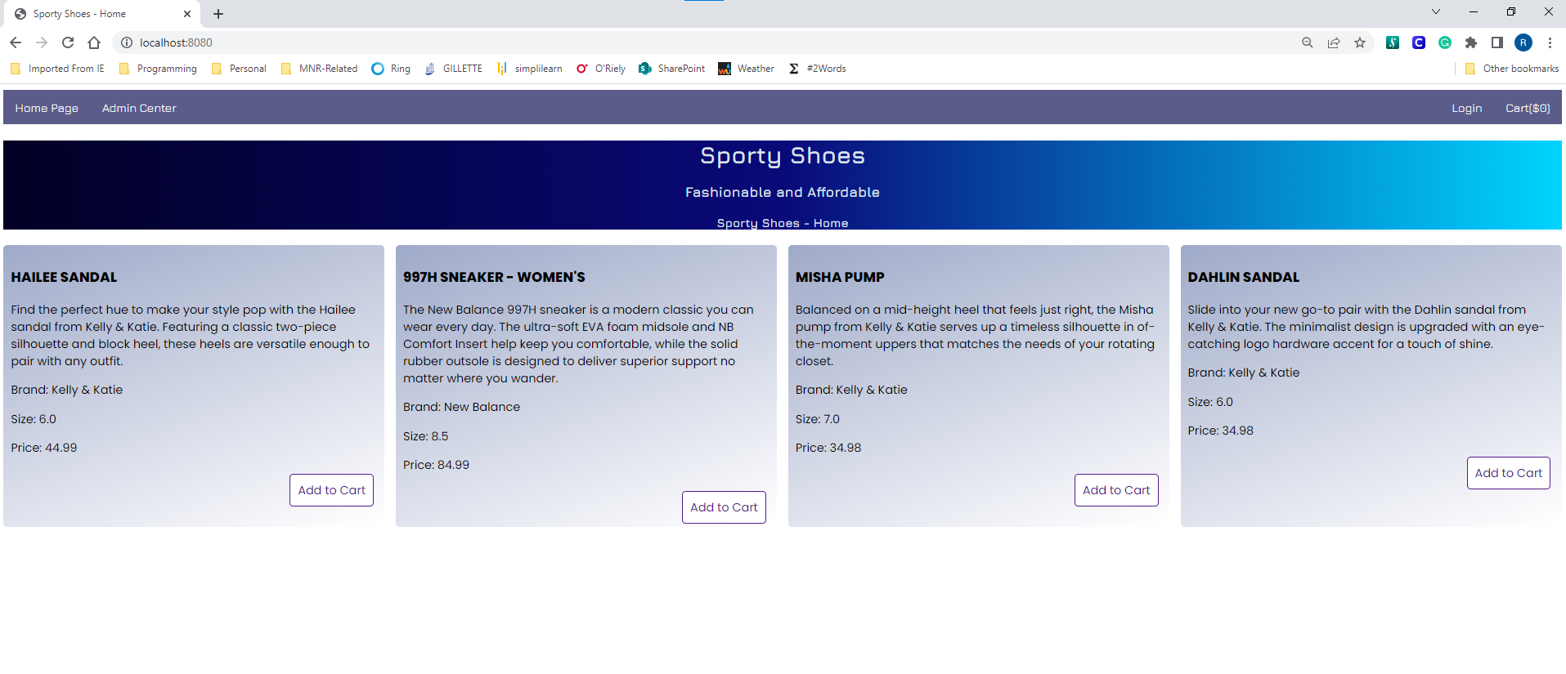
Landing Page

Slide 3
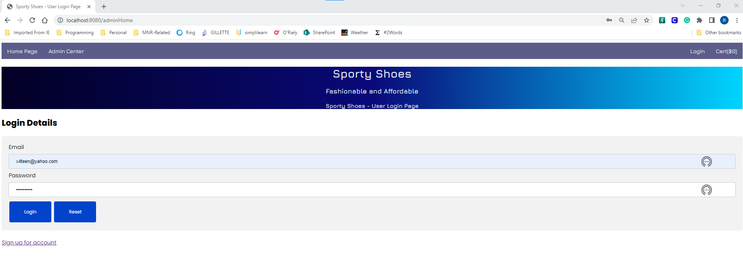
Universal Login - Page

Slide 4
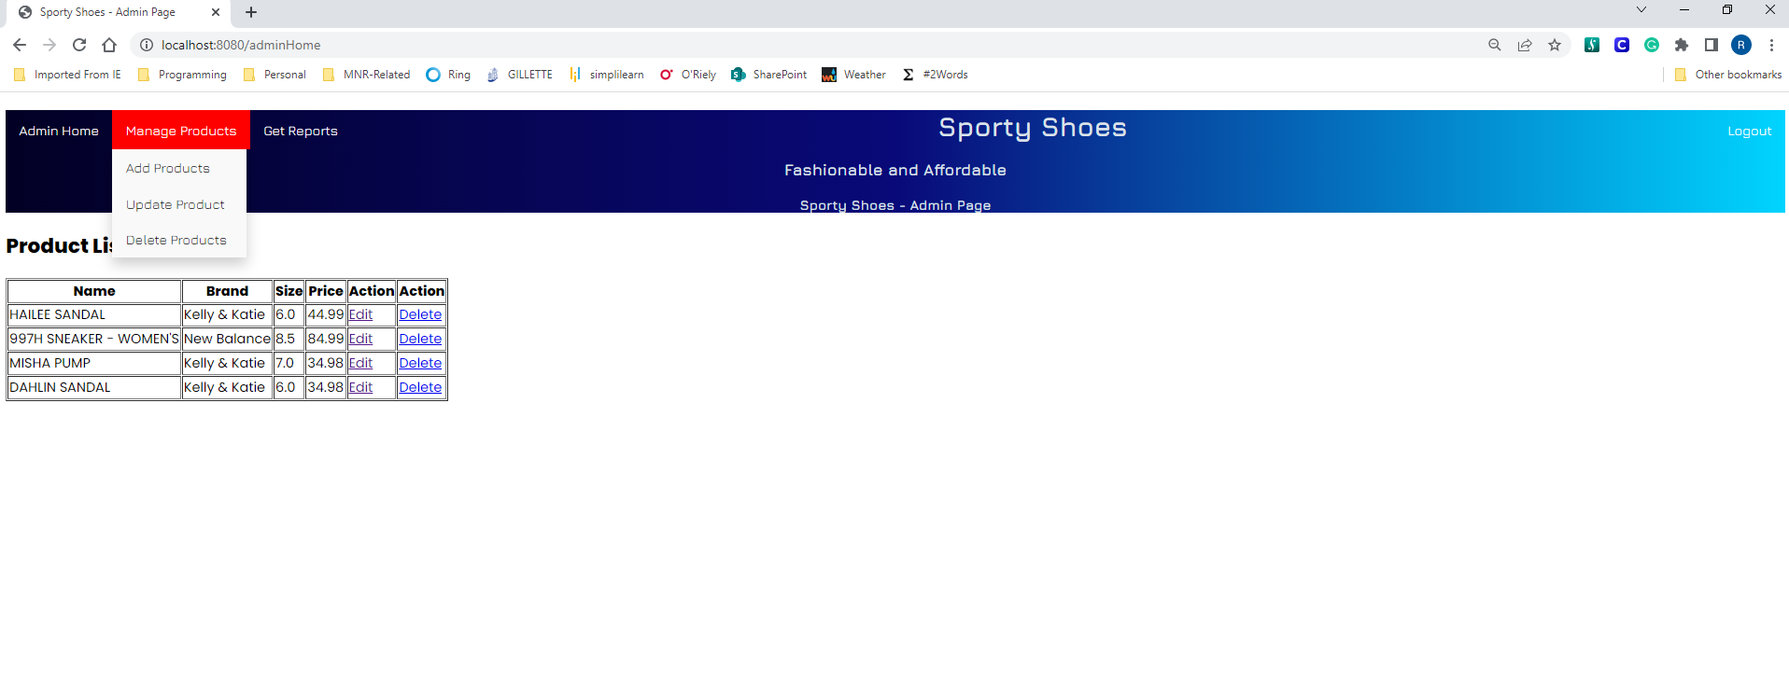
Admin – Home Page

Slide 5
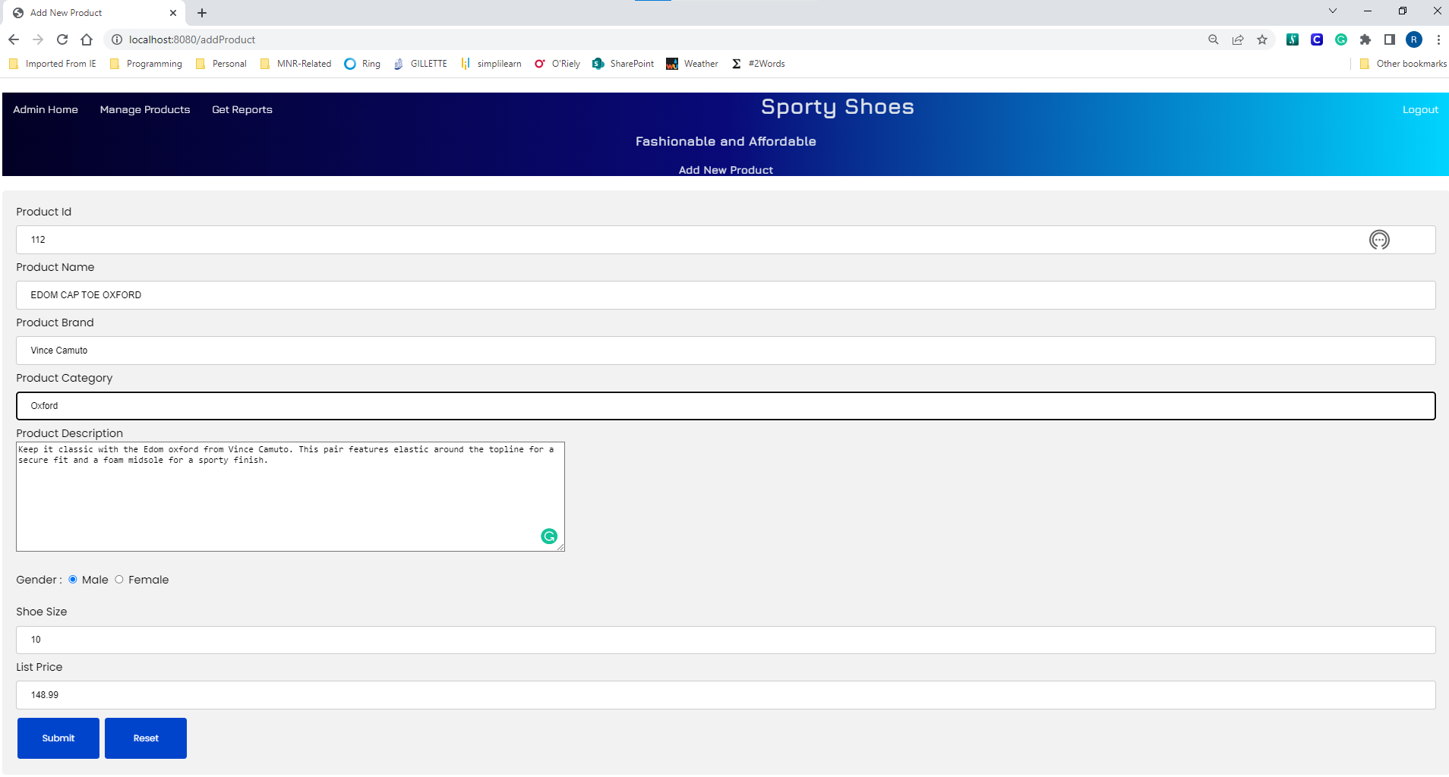
Admin – Add Product

Slide 6
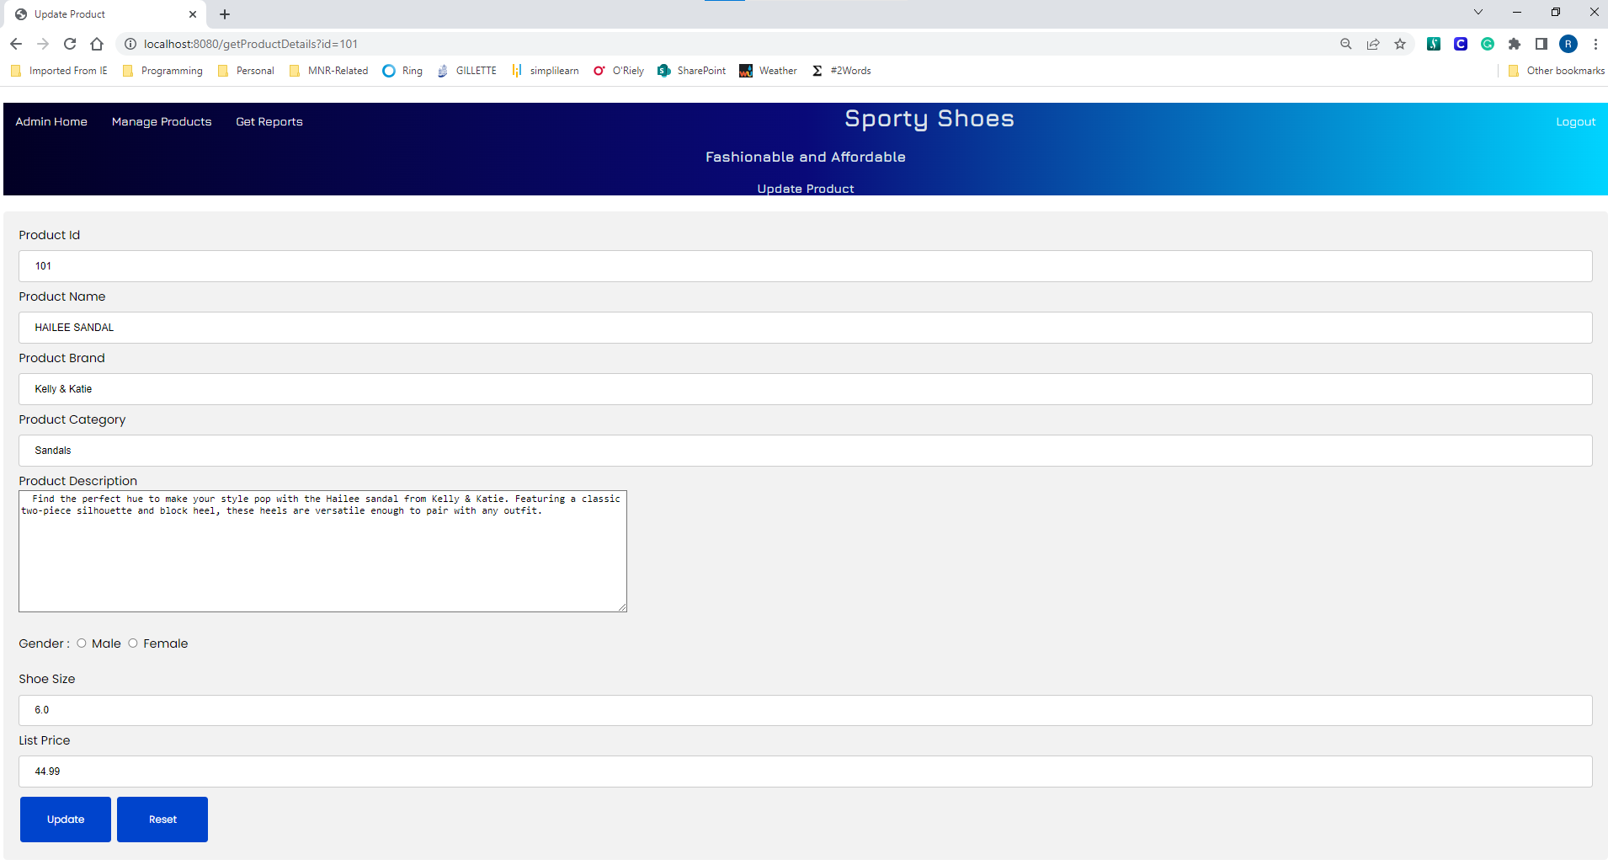
Admin – Edit Product

Slide 7
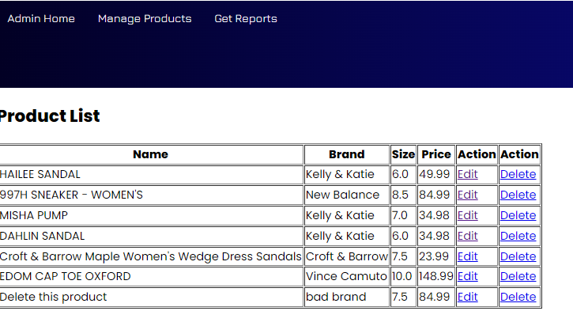
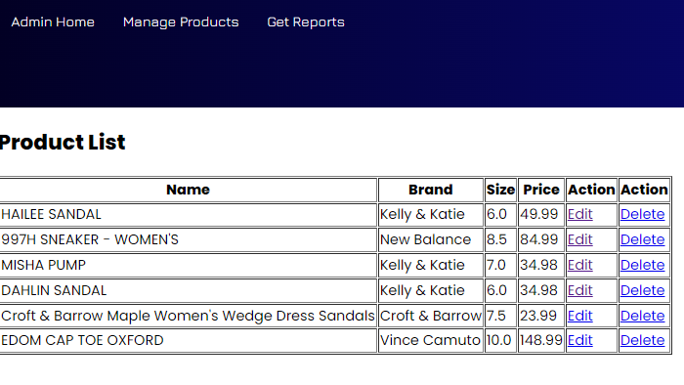
Admin – Delete Product
Before
After

Slide 8
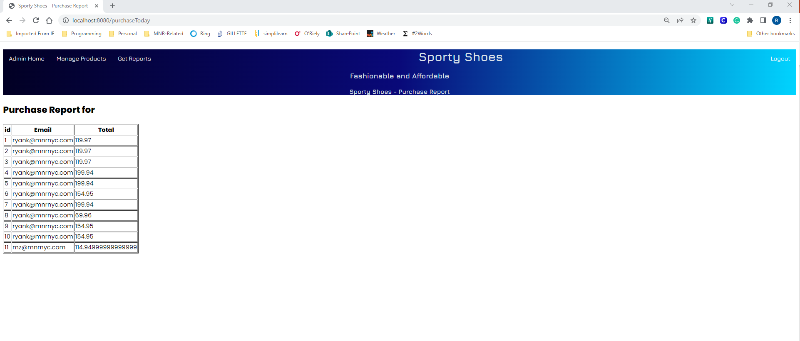
Admin – Purchase Report

Slide 9
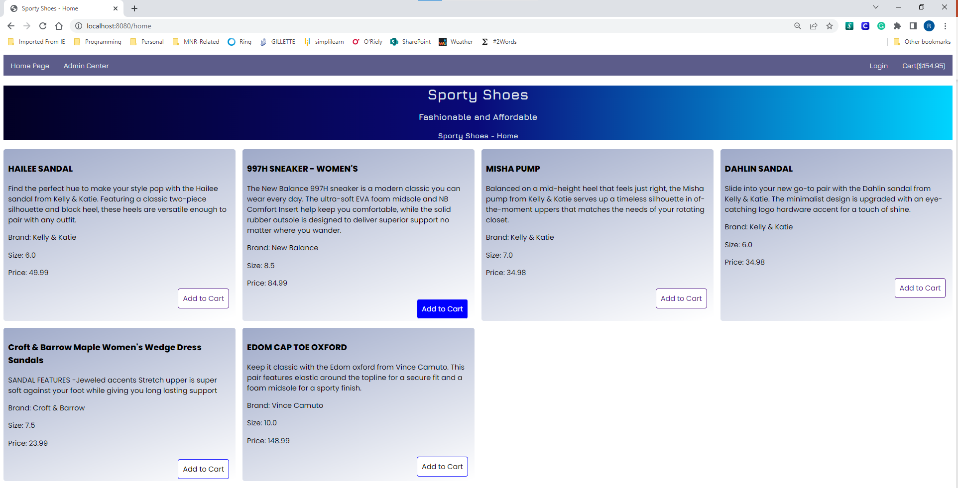
User (Anonymous) – Landing Page

Slide 10
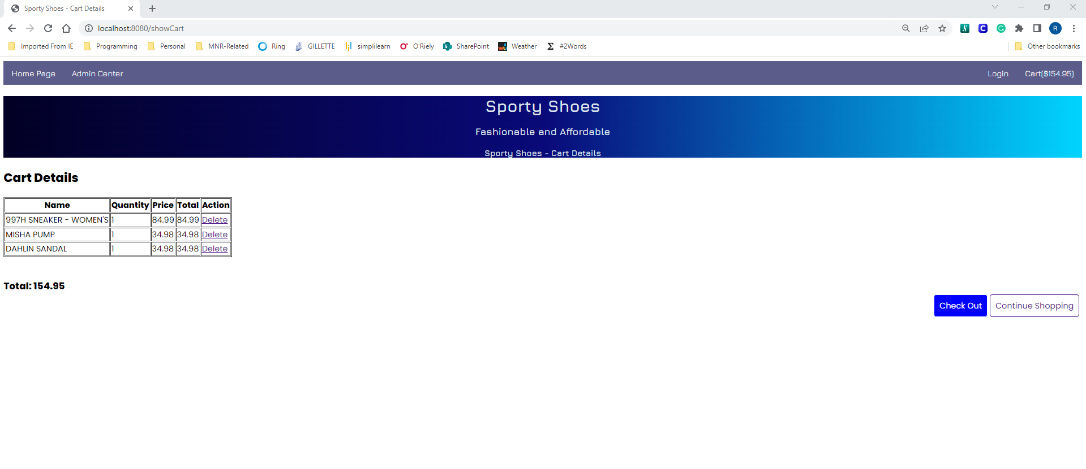
User (Anonymous) – Cart View

Slide 11
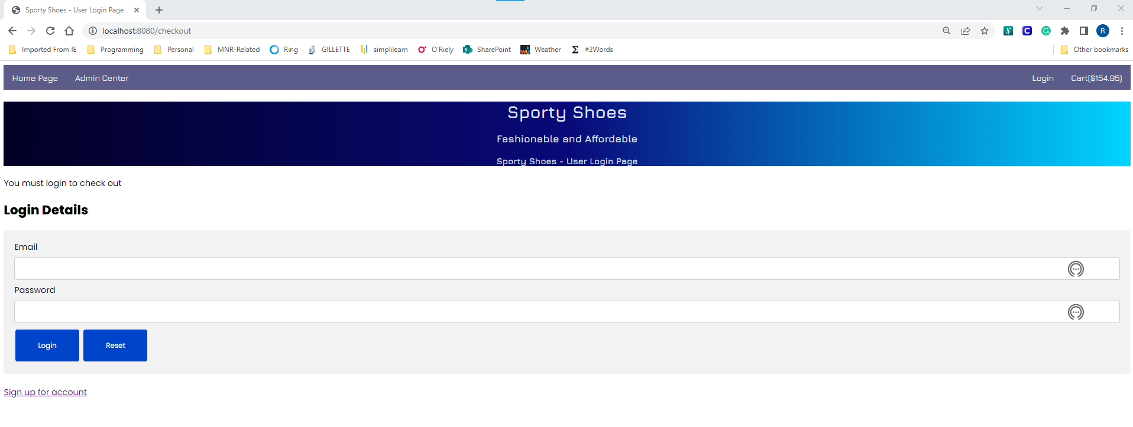
User Checkout – Login Before Check

Slide 12
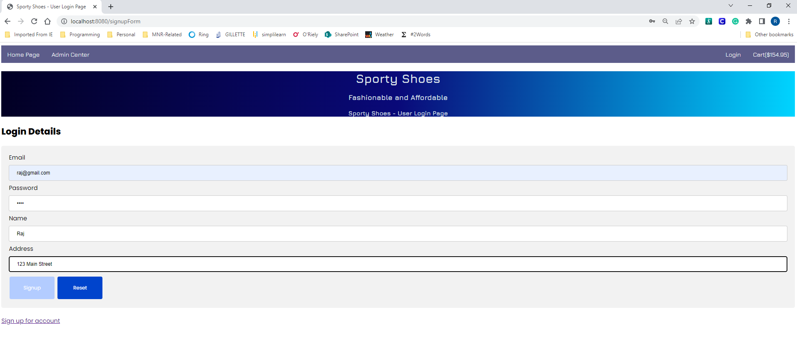
User Signup Page

Slide 13
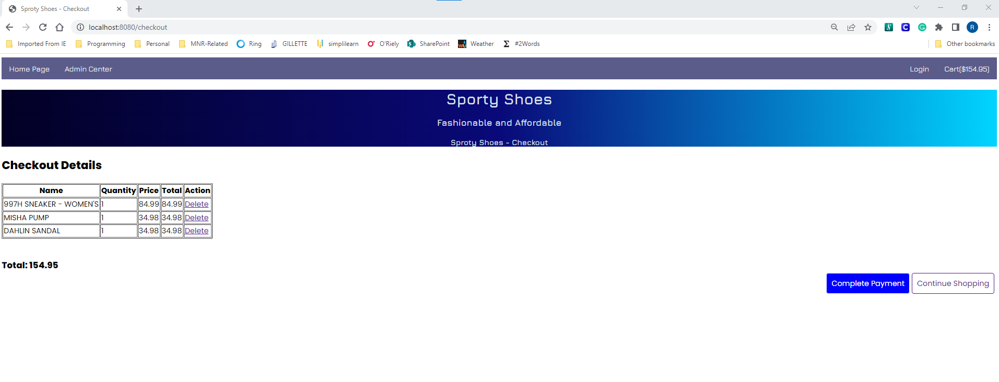
Signed-In User Checkout

Slide 14
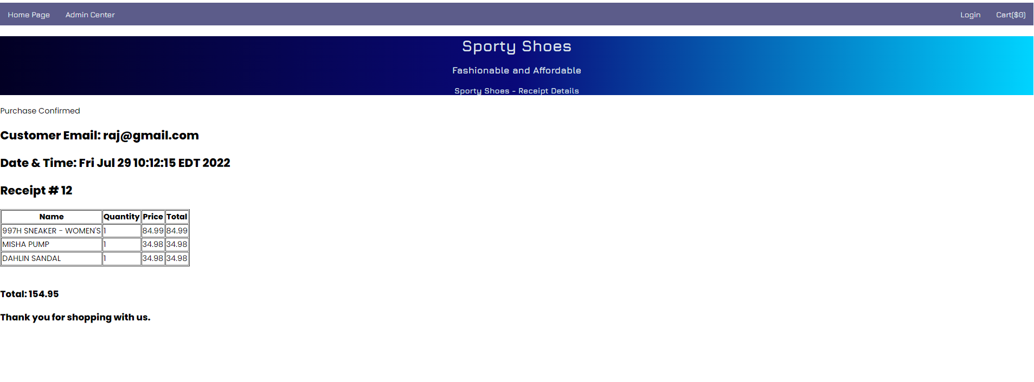
Receipt Page

